Slide 1

Welcome to the
OTTAWA

Slide 2
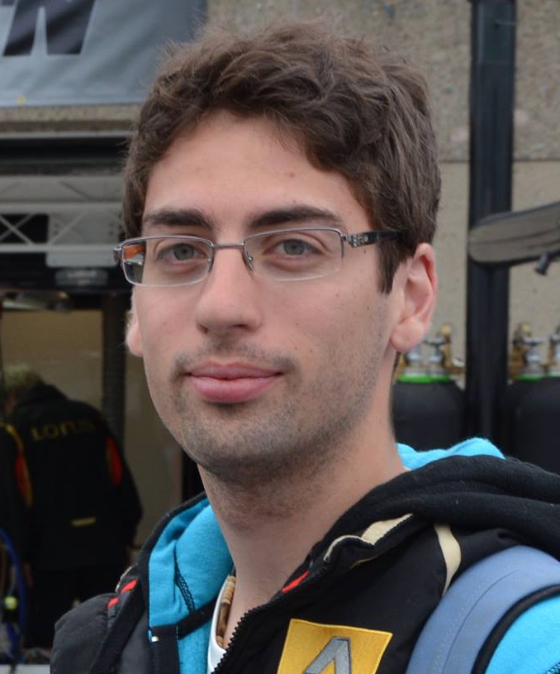
Vincent Lerouvillois
Senior .NET developer
Lixar
vlerouvillois@gmail.com

Slide 3
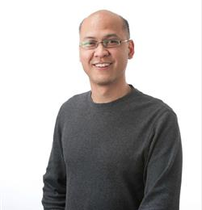
Edwin M Sarmiento
Managing Director
15C Inc
@EdwinMSarmiento
www.EdwinMSarmiento
linkedin.com/in/EdwinMSarmiento/

Slide 4
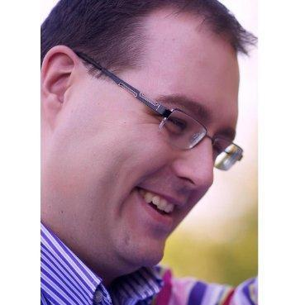
Eric Leonard
Infrastructure Architect
Deloitte.
@erleonard

Slide 5
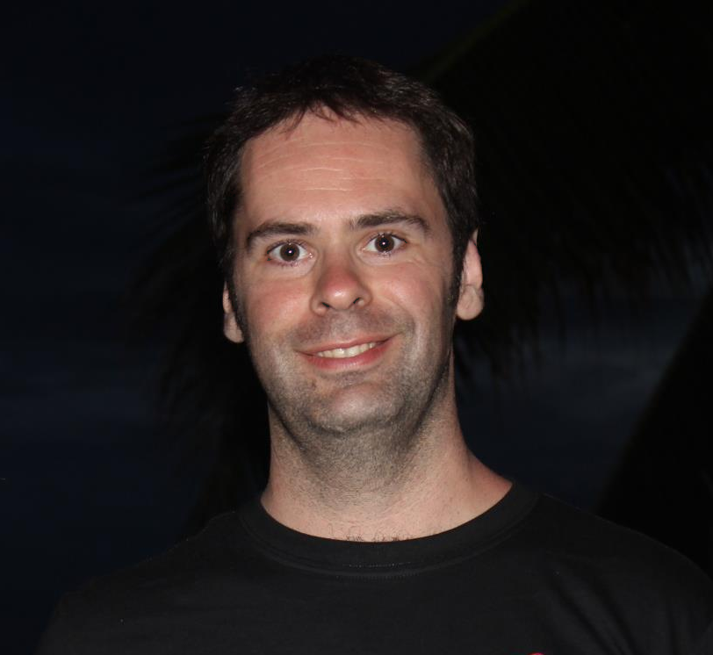
Chris Hardie
Senior developer
Lixar

Slide 6
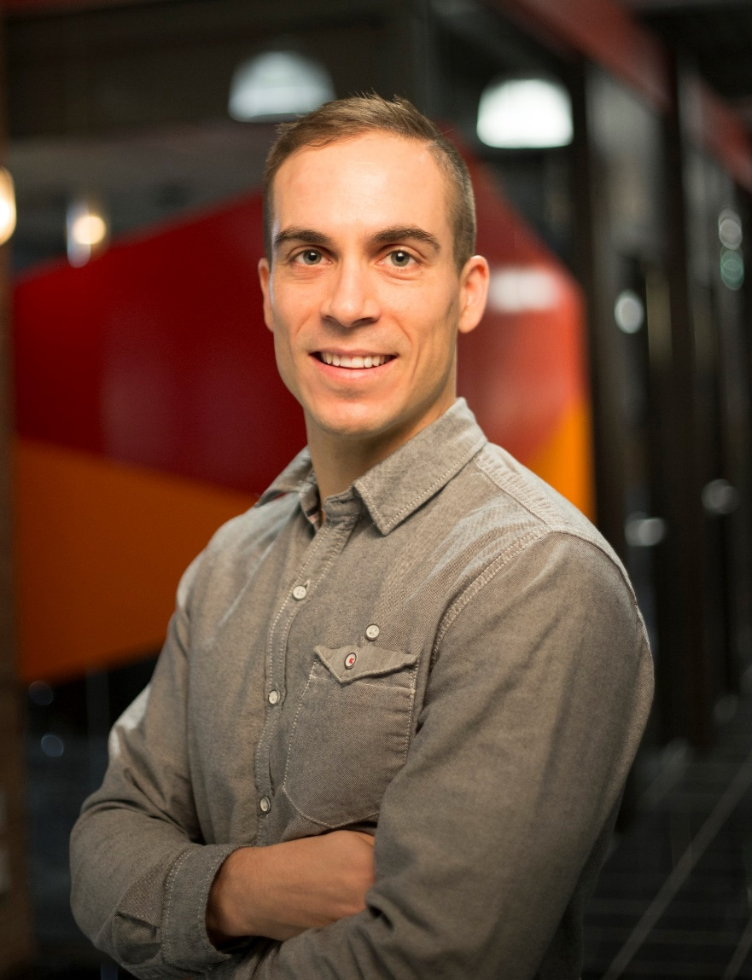
Marc Dugas
Technical Prime
Lixar

Slide 7
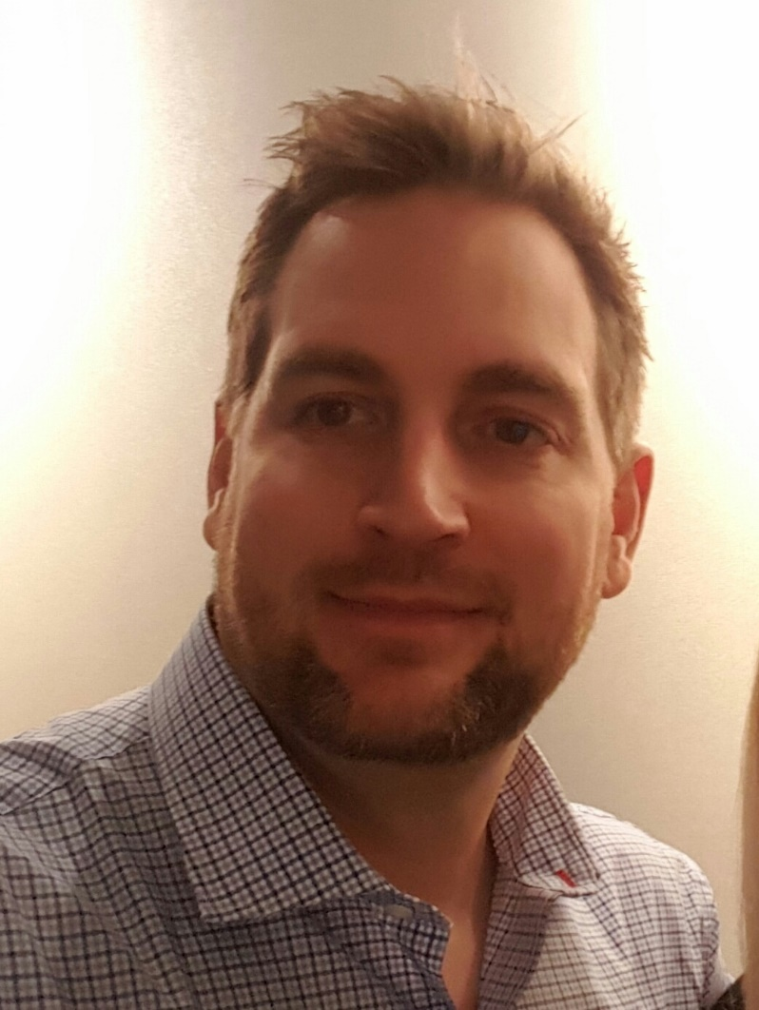
Joel Hebert
Director / Principal Consultant
Opulent ASP Development Inc.
MVP Visual Studio and Development Technologies
@JoelHebert
https://ca.linkedin.com/in/joelhebert

Slide 8
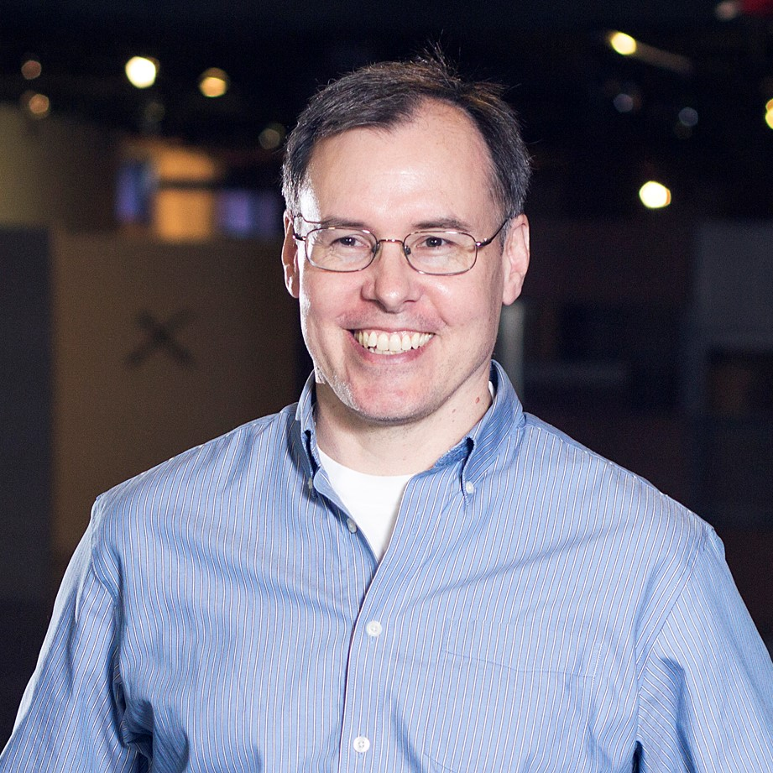
John Kirkham
Build and Deployment Specialist
Lixar
@devopsautomate

Slide 9

Carmai Constant
Principal Consultant
Axio Solutions

Slide 10
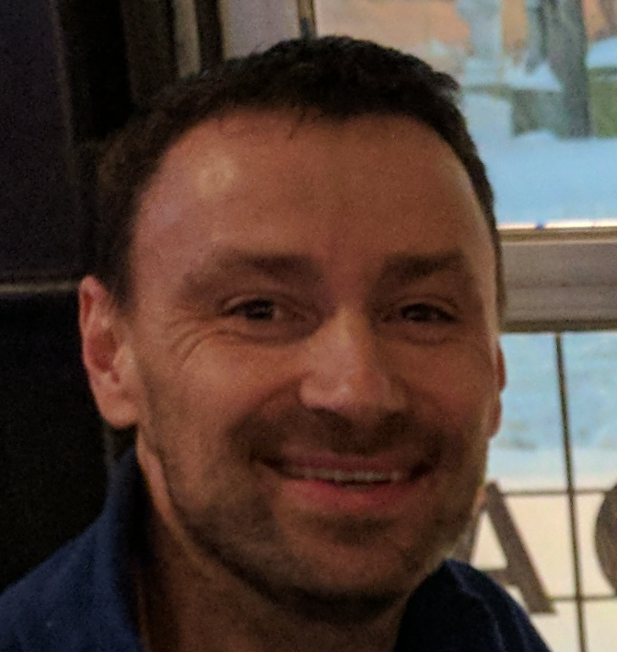
Arek Burcew
Principal Consultant
Axio Solutions

Slide 11
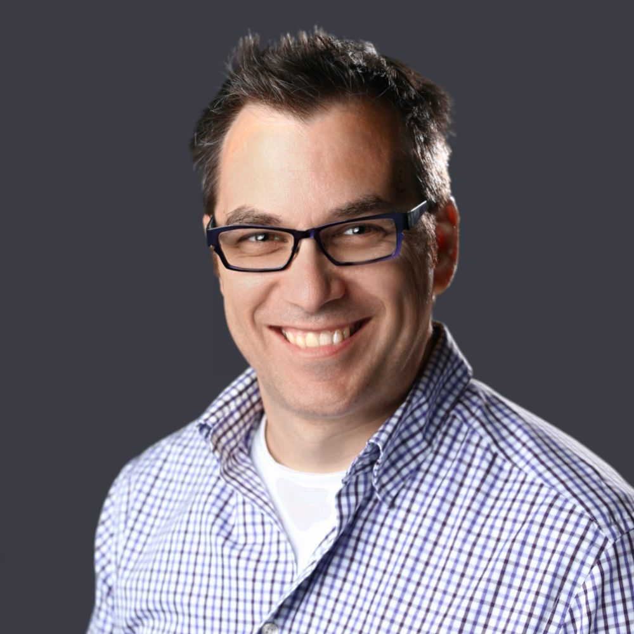
Frank Boucher
Cloud Solution Architect
Lixar
MVP Azure, Azure P-Seller
@fboucheros
linkedin.com/in/fboucheros
frankysNotes.com
cloudenfrancais.com

